Slide 1
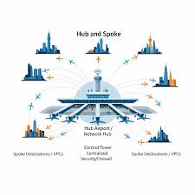
Hub-and-Spoke Architecture
Hadeel Al-bajali

Slide 2
Topics
Introductions
Jump VM (Security Gateway)
VNet Peering
Network Segmentation & Security
Azure Monitor & Diagnostics

Slide 3
Introduction
What is Cloud computing ?
delivers computing services over the internet instead of on-premises infrastructure. Organizations can use on-demand resources such as servers, storage, databases, and networking, enabling faster deployment, scalability, and cost efficiency through pay-as-you-use pricing.?
How is Microsoft Azure ?
cloud computing platform by Microsoft that provides services such as compute, storage, networking, databases, and AI. It operates on a global network of data centers, allowing organizations to deploy and scale applications securely and efficiently.

Slide 4
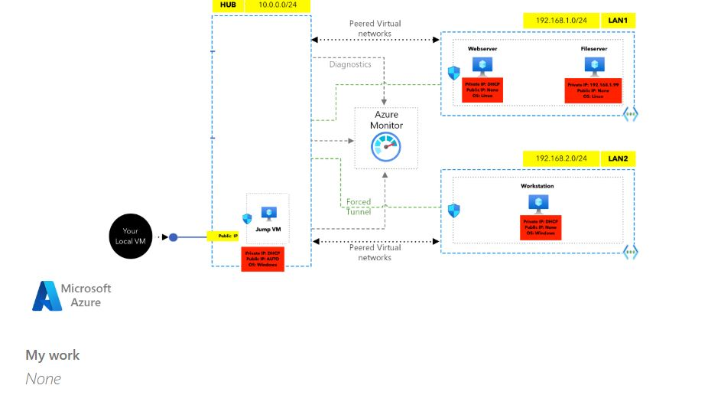

Slide 5
Hub-and-Spoke
What is Hub-and-Spoke?
is a network topology in which a central virtual network (Hub VNet) connects to multiple isolated virtual networks (Spoke VNets).The main idea is to centralize control and security in the Hub, while keeping application workloads isolated within the Spokes.
Why Use Hub-and-Spoke?
Strong isolation
Centralized security
Easy scalability
Hybrid-ready

Slide 6
Jump VM (Security Gateway)
A Jump VM (also called Jump Box or Bastion host) is a hardened virtual machine used as the single-entry point into private networks.
It is usually the only VM with a Public IP.
connect to it first (RDP/SSH), then access internal VMs using private IPs.
This design reduces the attack surface by preventing direct internet access to internal servers.
All administrative access can be logged and monitored from one place.
Why it matters: Centralized access control + easier auditing + lower risk.
6

Slide 7
VNet Peering
VNet Peering connects two Azure virtual networks privately using Microsoft’s backbone network.
Provides low-latency, high-bandwidth connectivity.
Traffic does not traverse the public internet.
Peering is non-transitive: Spoke A can talk to Hub Spoke B can talk to Hub Spoke A cannot talk to Spoke B unless explicitly routed
Why it matters :Secure and efficient connectivity while preserving network boundaries.
7

Slide 8
Network Segmentation & Security
Network segmentation means separating workloads into different networks or subnets based on their role and sensitivity. Web servers, databases, and workstations are placed in separate spokes or subnets. Access between segments is controlled using NSGs, route tables, and firewalls.
Follows Least Privilege and Zero Trust principles.
Why it matters: If one segment is compromised, the attacker cannot freely move across the network (limited blast radius).
8

Slide 9
Azure Monitor & Diagnostics
Azure Monitor provides centralized visibility into infrastructure and network activity.
Collects metrics (CPU, memory, network usage).
Collects logs (VM activity, network flows, security events).
Uses Log Analytics to query and analyze data.
Helps detect: Failed login attemptsUnusual traffic patterns Performance and availability issues
Why it matters: Security without monitoring is blind. Monitoring enables detection, investigation, and response.

Slide 10
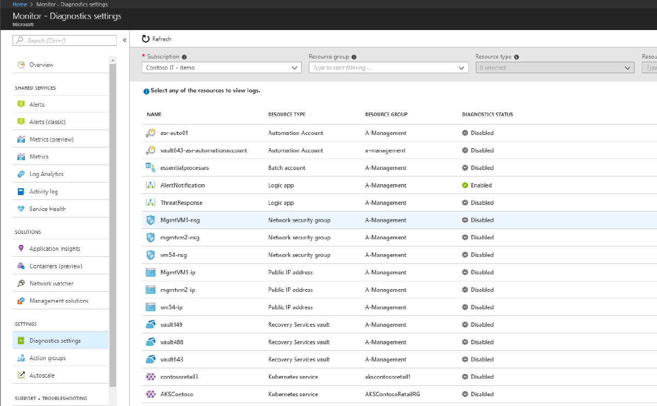
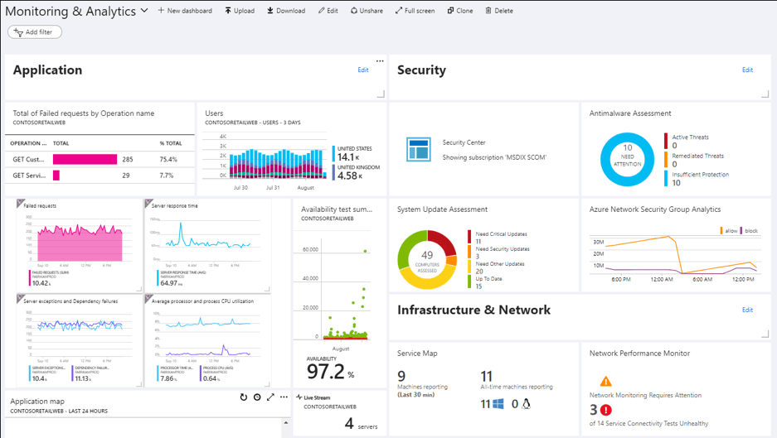
Azure Monitor & Diagnostics

Slide 12

Git Hub

Slide 13

Thank you

